Slide 1






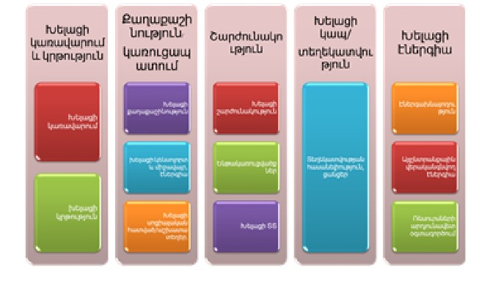
Key Performance Indicators for Smart Sustainable Cities to address the major development issues and implement SDGs United Smart Cities Project by UNECE Regional Forum on Sustainable Development for UNECE Region 1st of March, 2018, Geneva
Nune Harutyunyan, Director
Regional environmental center for Caucasus
Smart City Focal Point,
State Committee on Urban Development
Republic of Armenia

Slide 2
Key Performance Indicators for Smart Sustainable Cities
Summary
The case study highlights the approach of developing a smart sustainable city profile for the city of Goris, by using the Key Performance Indicators for Smart Sustainable Cities. The case study will show how the use of indicators is crucial to formulate policy recommendations, enable transparency, engage all relevant stakeholders and promote sustainable urban development.
Goris is a medium-sized city in Armenia and is located in the southern province of Syunik. The city currently has 23,200 inhabitants and is the second-largest city in Syunik region. It is considered one of the most important historical and cultural sites in Armenia and a favoured touristic destination . Goris is also interesting from an environmental point of view despite the fact it is quite prone to natural hazards, in particular to earthquakes and landslides.
The economy of the city is mainly based on light industry, and it is home to several food-processing plants. Other quite developed industrial sectors are those of electric energy, food, textile and sewing, aluminium and metal-plastic products, woodworking and stone processing, and electronics.
Strategy chosen
Phase 1: The Expert Engagement and Stakeholder Consultations
The fact-finding mission to Yerevan and to Goris, was undertaken from 9 to 13 February 2015. It was organized by the UNECE, the State Urban Development Committee of Armenia, the city of Goris, UNDP and REC Caucasus.
Project strategy, Goris Smart City Profile and KPI indicators were elaborated based on stakeholder engagement, recommendations, interviews desk research, an results of expert workshop and a stakeholder consultations.
Collection of information on data and perceptions related to the current situation of the city’s sustainable development priorities, covering economy, environment, urban planning, energy-efficiency, social perspectives.

Slide 3
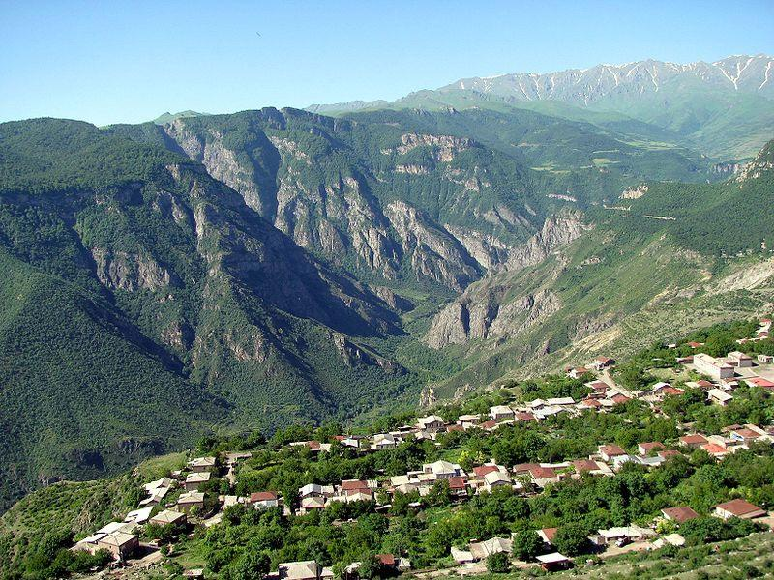

Slide 4
EVALUATING CITIES' PERFORMANCES WITH Smart Sustainable Cities Indicators (SSCIs)
The city's performance was evaluated using the Key Performance Indicators for Smart Sustainable City Indicators, developed by UNECE, ITU, RA Committee of Urban Development and REC C and in consultation with other stakeholders. The list includes 72 indicators which are grouped under the following structure:
Pillars of sustainability: economy, environment, society and culture;
Thematic areas of indicators. Eighteen (18) major thematic areas including ICT, innovation, employment, Trade, productivity, physical infrastructure, energy, air and environmental quality, noise, biodiversity, education, health, culture, housing, safety and social inclusion
Typology of indicators:
Core indicators can be used by all cities globally.
Additional indicators may be used by some cities according to their economic capacity, population growth, geographic situation, etc. These indicators are optional, especially for self-benchmarking. They are not normative.
The above-mentioned indicators have been used to develop the Smart Sustainable City Profile of Goris. The Profile helps the local authorities to understand the needs of the city in order to become “smarter” and more sustainable. The list of KPIs was finalized in 2017 under the initiative United for Smart Sustainable Cities (U4SSC) which includes 16 UN bodies and other partners.

Slide 5
Results and impact
The analysis of the city of Goris supported by the Key Performance Indicators and described and addressed in the Smart Sustainable City Profile for Goris produced the following impacts:
It supported
city to assess its performance in the areas of environmental sustainability, economic and social development and culture;
city to identify its strengths and weaknesses and set priorities for action;
enhanced cooperation among city stakeholders on urban development activities
promoted the implementation of the SDGs and the New Urban Agenda at the local level;
increased the city’s visibility at the national and international level.
Promoted knowledge and best practice transfer concerning sustainable urban development
Took sustainable development in cities at a global level;
We have produced the following Smart Sustainable Cities Profile for Goris: the Profile is a study of the current situation of a city by using the above-mentioned KPIs. Profiles measure the city's performance against the Indicators.
Goris has become a member of United Smart Cities platform: the online platform, which can be found at http://unitedsmartcities.com/, provides a place where stakeholders can share expertise, good practices, and lessons learned, in relation to smart and sustainable urban development.
Challenges
One of the key challenges identified during the design of the Goris Smart City profile was lack of data in some particular areas, for example of some of environmental matters and indicators, due to which data on cities was not collected or updated. Diversification of collection practices according to the different city/country/region departments and offices;
Lack of human and financial resources to mantain a good database or to collect data;
Expertise, skills and information on which data to collect.

Slide 6
Smart city components
Education and smart governance
Smart (good) governance
Smart Urban Development
Smart Urban Development
Smart Environmental Management
Smart Energy
Smart mobility
Smart mobility
Infrastructre
Smart IT
Smart networks
Information
Available smart information network system
Smart Social cohesion and Employment
Smart Energy
Energy efficienty
Alternative and renewable energy (sources)
Resource efficiency
Smart education

Slide 7

http://unitedsmartcities.com/

